Slide 1
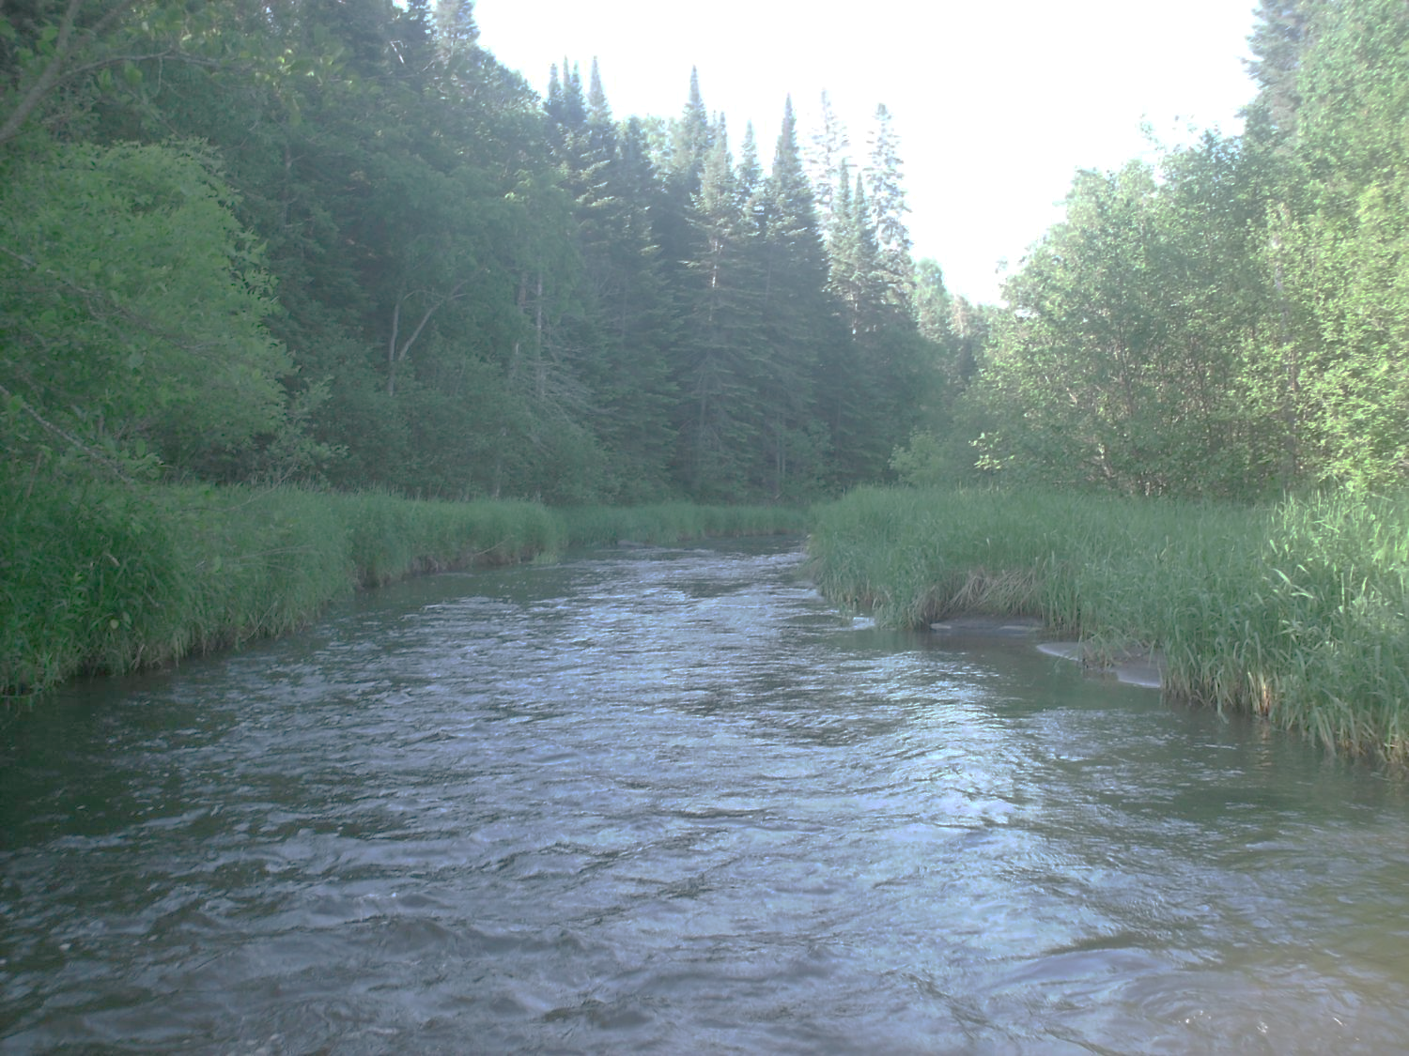
Legislative Water Commission
November 13, 2018
Co-chairs: Senator Wiger * Representative Torkelson
Presiding
Jim Stark, Director
Straight River, Becker County
1

Slide 2
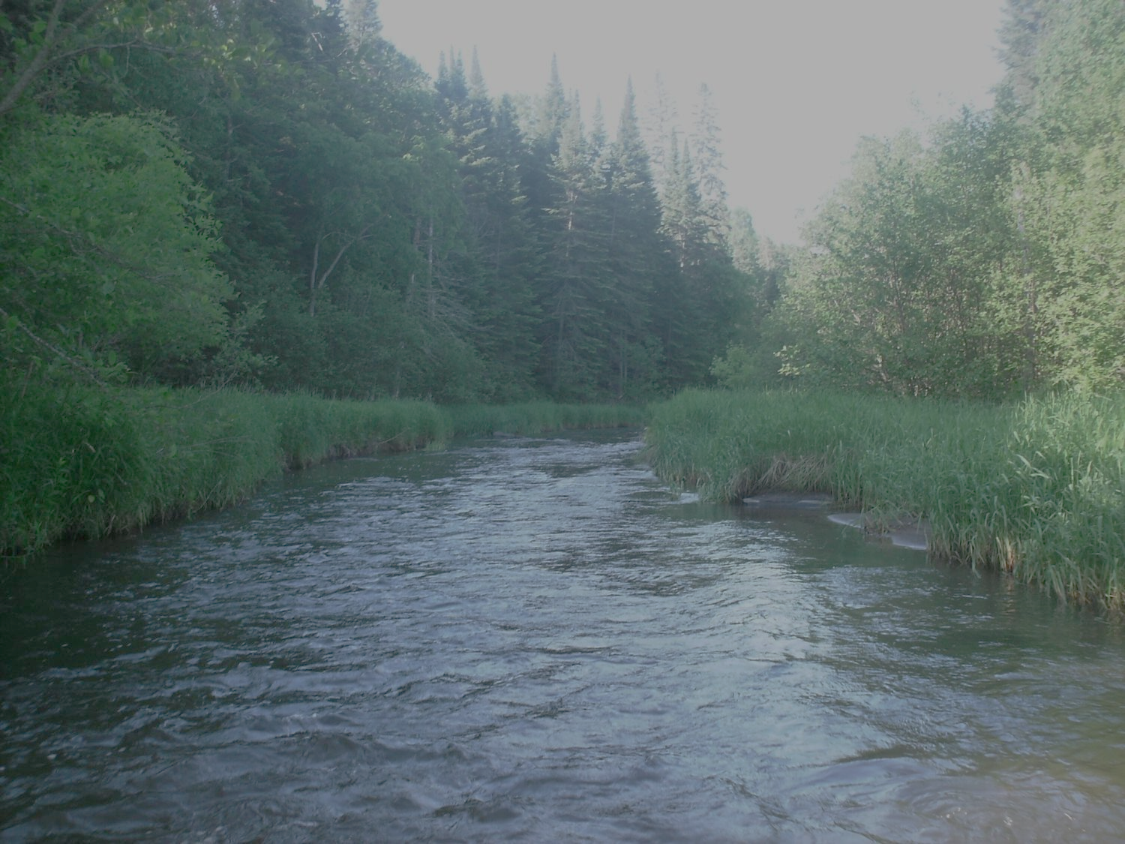
Legislative Water Commission
Tuesday, November 13, 2018 (1 pm)
State Office Building: Room 10
Rep. Paul Torkelson, Chair
*Sen. Chuck Wiger, Co-Chair
* Presiding
Agenda
Approval of minutes– October
Monthly Update-Jim Stark
Recommendation Summary
Member Discussion of Recommendations
Break
Briefing, Steve Riedel, Minnesota Trade Office (DEED)
Member Consensus of Recommendations
Next Steps in Recommendation Process
Future meetings
Adjourn
2

Slide 3
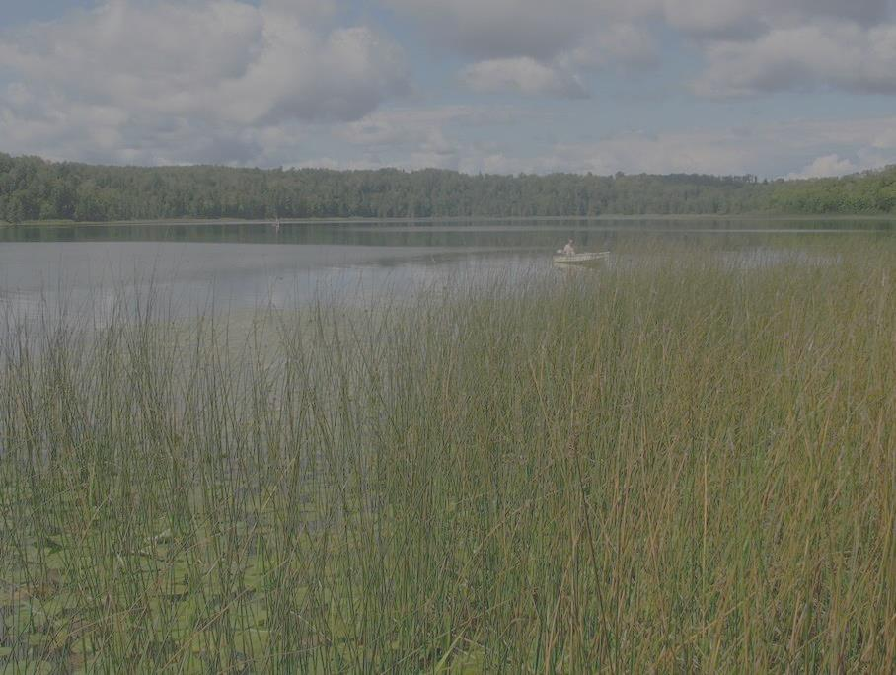
Activity Update:
MDH/UM drinking water planning
McKnight planning for Mississippi River
GLRI restoration efforts
Border Lakes binational planning
CWC priorities
LCCMR priority planning
UM Water Resources Conference
MGWA conference—gw planning
EI meeting on source water protection
Met Council water supply coordinating teams
DEED- Steve Riedel- water industries

Slide 4
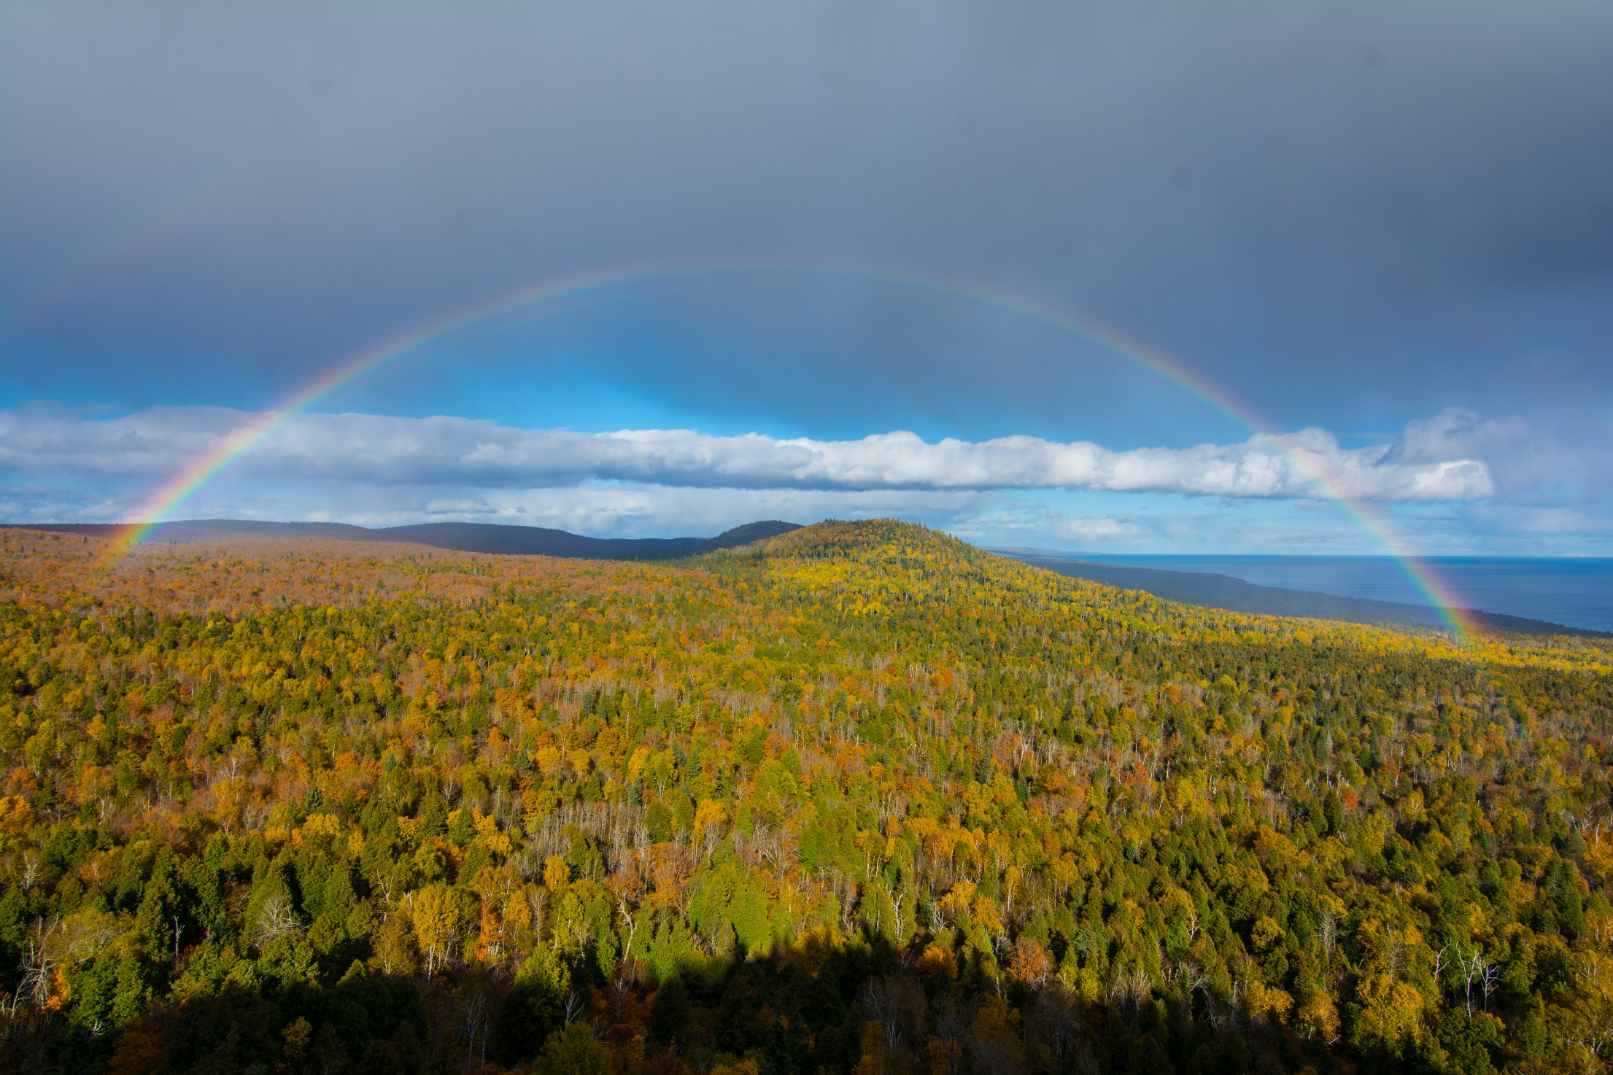
Minnesota-- State of Water
Notes:
to the northern forests

Slide 5
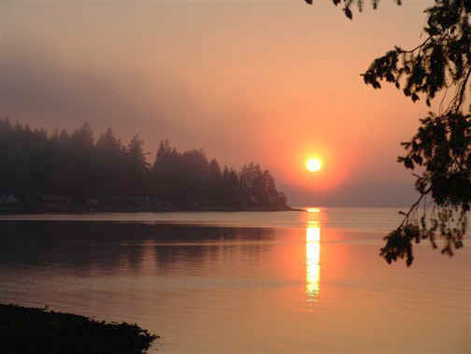
2019 Recommendations
Notes:
For more information and real time monitoring data you can visit this web site.

Slide 6
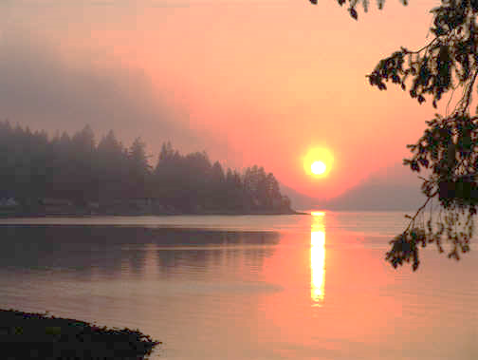
12 Recommendations
Inflow and Infiltration-- Wastewater
Healthy Soil/Healthy Water
Water Infrastructure
Peer review of wastewater standards
Reducing excess Chloride
Continuation of the LWC
Keeping Water on the Land
Data, information, Education and Public Awareness
Preserving and protecting our lakes
Expanded source water programs
Increase drinking water protection Fee
Statewide Water Policy
Notes:
For more information and real time monitoring data you can visit this web site.

Slide 7
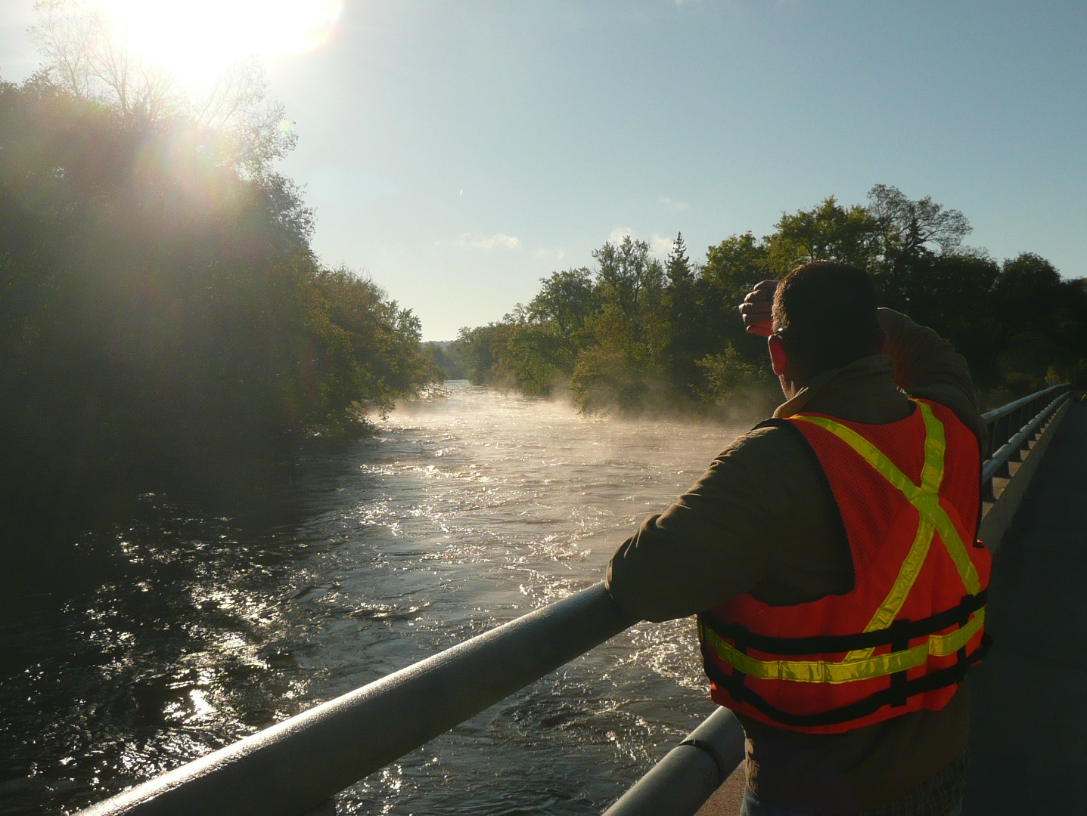
Pathway to the recommendations
7

Slide 8
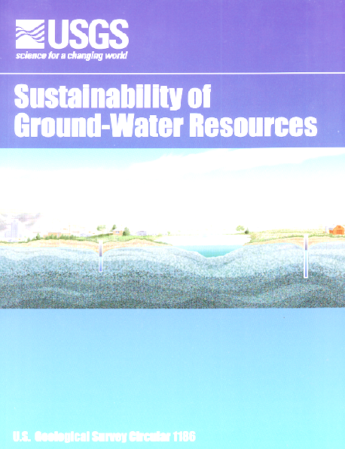
Step 1: Review of
reports and existing
recommendations

Slide 9
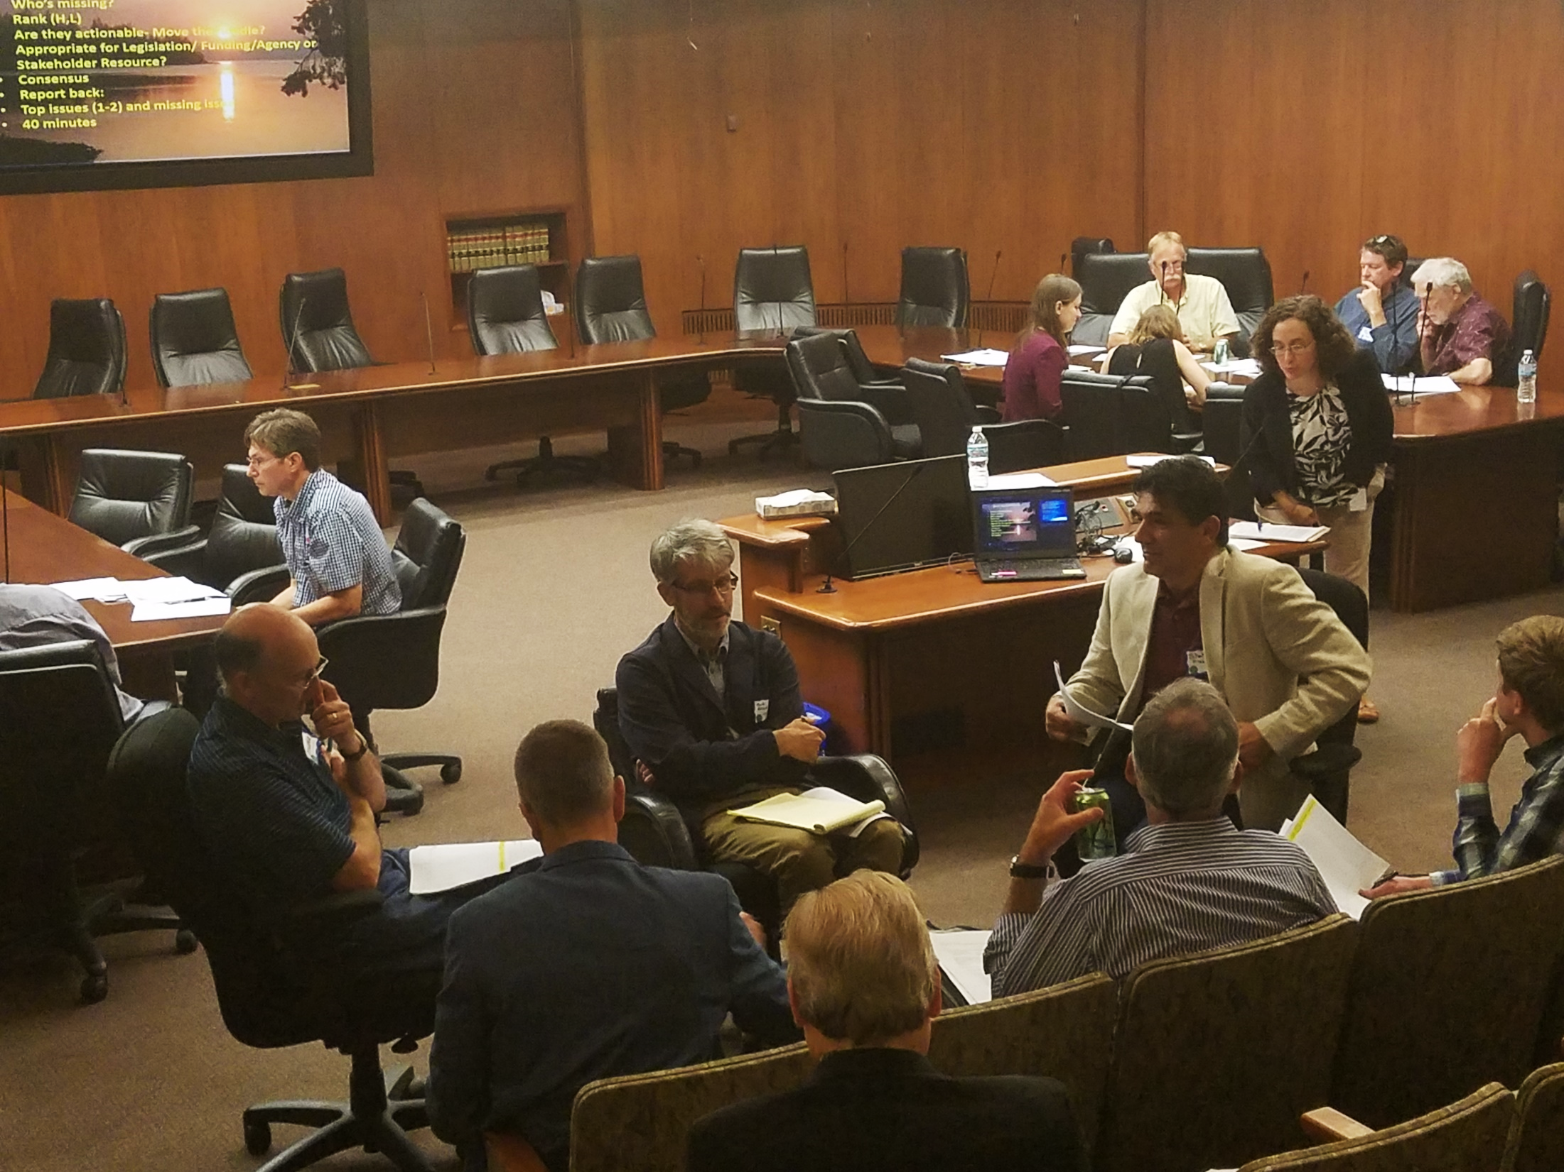
Step 2: Five Stakeholder meetings
Six Issues
About 100 recommendations

Slide 10
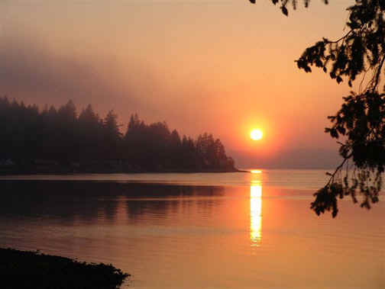
Thanks!
Step 3: Survey follow-up
188/450 responses
Notes:
For more information and real time monitoring data you can visit this web site.

Slide 11
Step 4: Ranking Recommendations

Slide 12
12 Recommendations
Inflow and Infiltration-- Wastewater
Healthy Soil/ Healthy Water
Water Infrastructure
Peer review of wastewater standards
Reducing excess Chloride
Continuation of the LWC
Keeping Water on the Land
Data, information, Education and Public Awareness
Preserving and protecting our lakes
Expanded source water programs
Increase drinking water protection Fee
Statewide Water Policy
Notes:
For more information and real time monitoring data you can visit this web site.

Slide 13
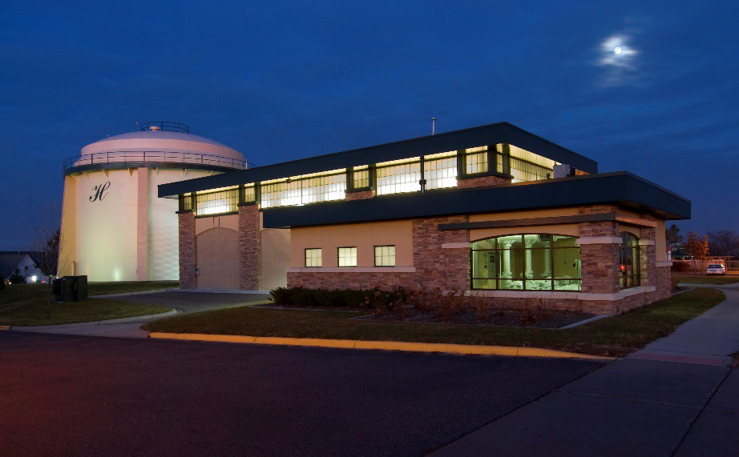
# 1) Wastewater: Inflow and Infiltration
-Leakage into sewer lines is a
Major problem
-Increases treatment volumes
-Reduces treatment efficiency
Legislation to allow
sanitary districts use of
existing revenue to fix these
problem– as cities can

Slide 14
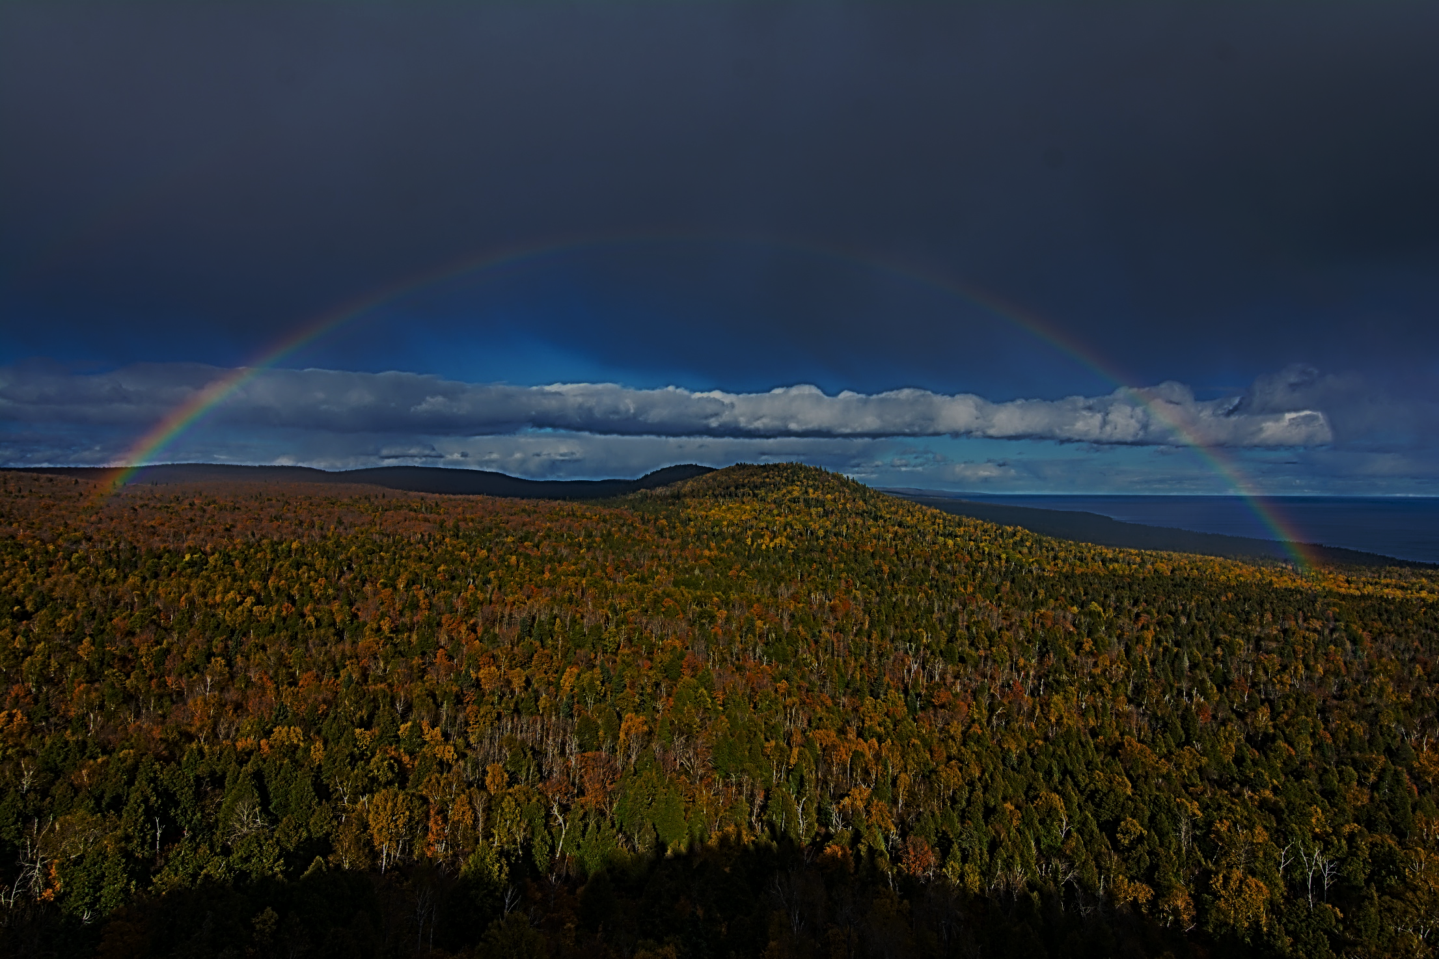
# 2) Healthy Soil/Healthy Water
Healthy Soil=Productive Agriculture and Healthy Water
Focus is on improving soil health and water retention and quality
Provide support for UM, MDA, BWSR and CWC efforts for the long term (general fund)
Initiate an interagency/UM statewide soil-health action plan
Notes:
to the northern forests

Slide 15
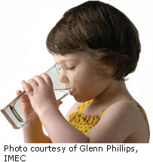
# 3) Improve Water Infrastructure
Water infrastructure is aging
Significant problem for small cities
Support long-term continuous GO bonding
New and increased support for cities: efficiencies, alternatives, technical assistance, asset management, regional cooperation, water-quality trading, incentives for failing septic systems
General Funds: coordinate with and increase ongoing programs and pilots: PFA, MPCA, MDH, PFA
Notes:
What we hope to leave you with is a much better understanding of our state’s groundwater resources and appreciation for the challenges we face.
Simply stated the problem we are increasingly recognizing is that there are ….

Slide 16
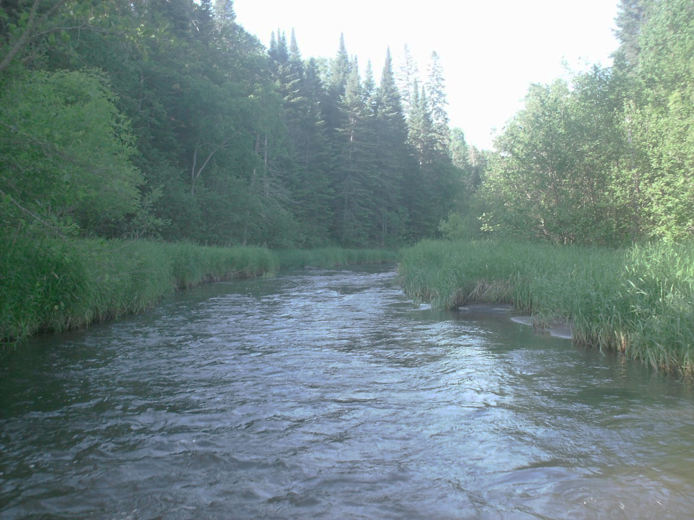
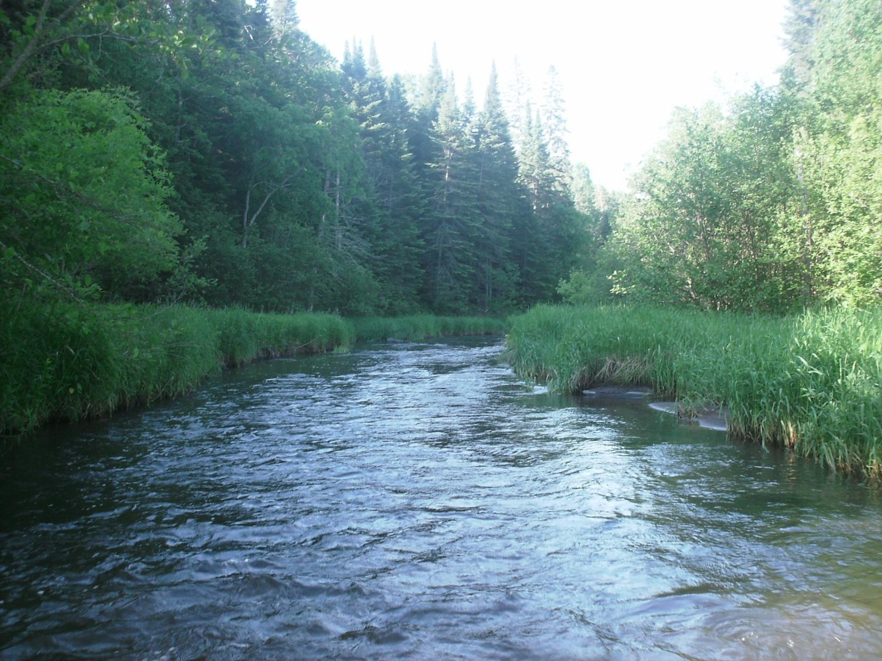
# 4) Peer Review of Wastewater Standards
Wastewater standards change and evolve over time
Presents a burden for small cities
Change typically follows a defined EPA process
However, state- mandated changes are not mandated by the EPA
State mandated changes use a similar MPCA Commissioner’s Order process
Legislation to memorialize order into statute
Peer Review of Wastewater Standards
16

Slide 17
# 5) Over-Use of Chloride Deicers
Chloride is over applied in some areas
Degrades streams and groundwater
Septic systems and water softening contribute to the problem
MDOT and cites have made good progress
Commercial applicators need assistance
General funds to continue applicator training
Extend training statewide (MPCA)
Legislation: limited liability for
qualified applicators
Assess other sources

Slide 18
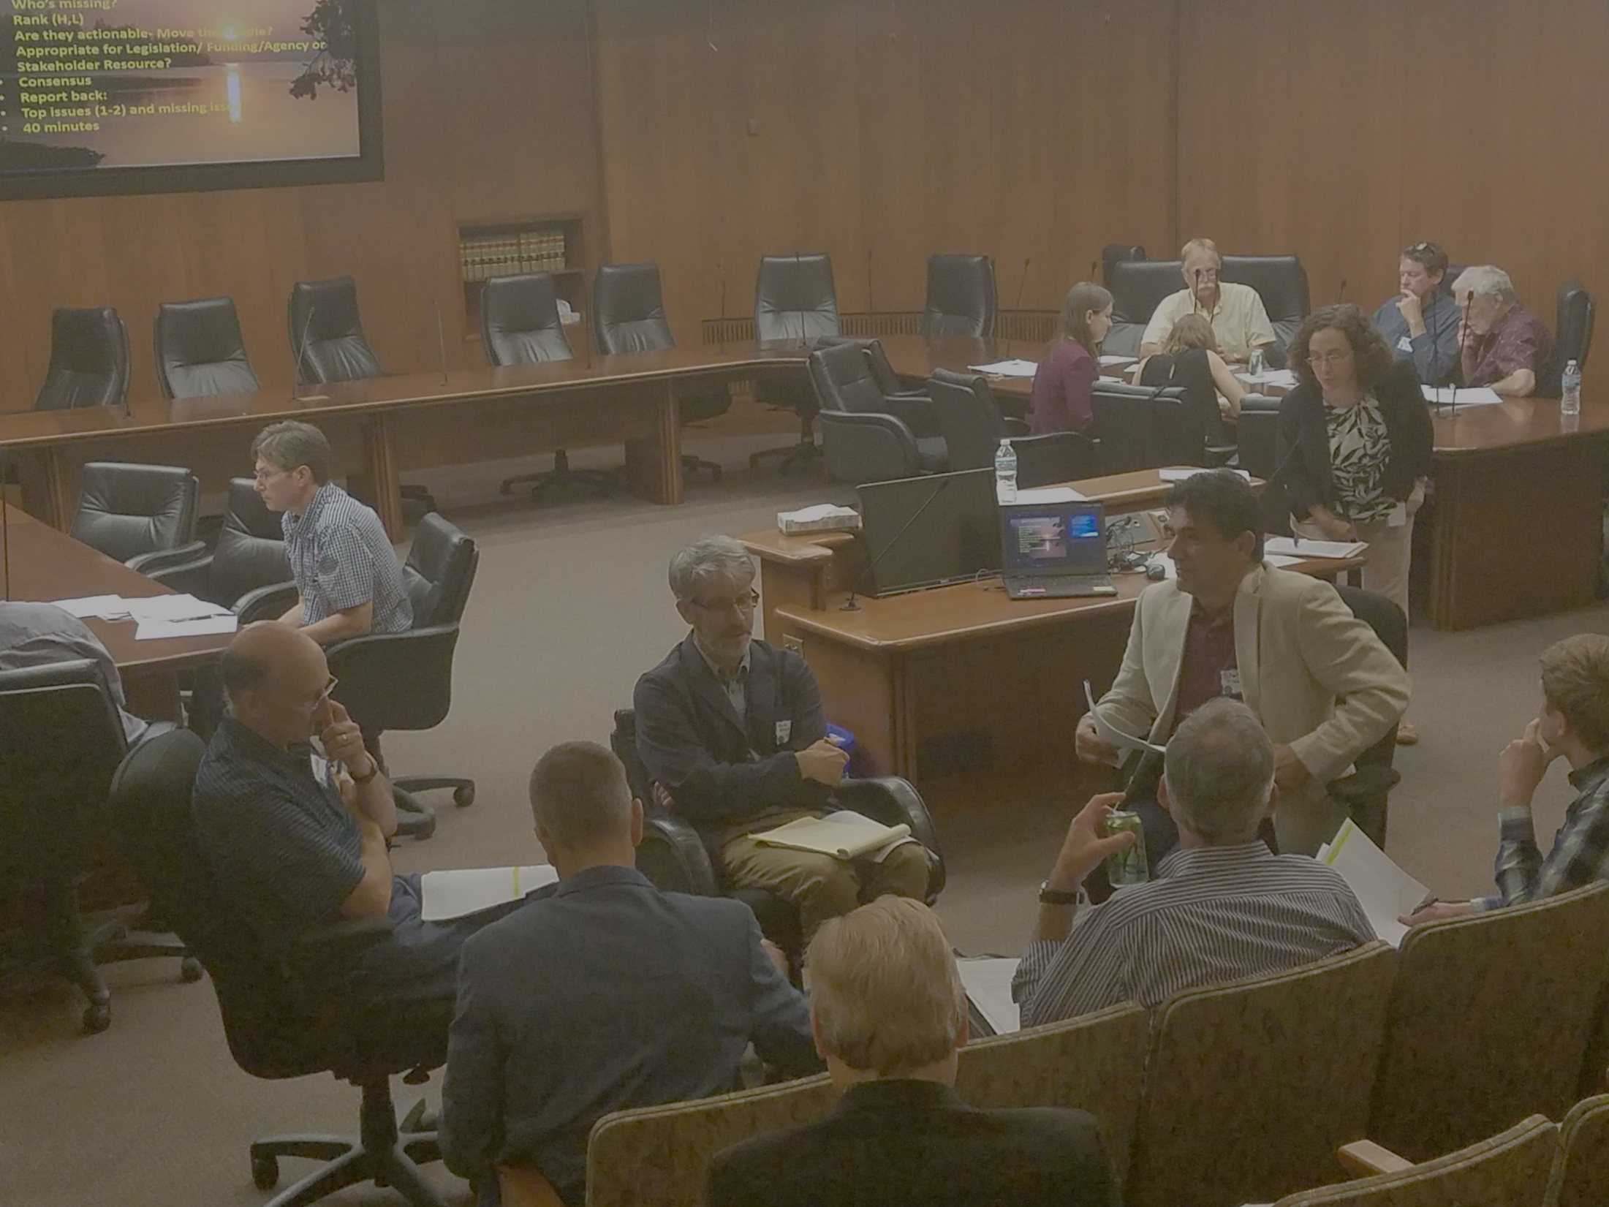
# 6) Continuation of the LWC
LWC:
Improved coordination with other Legislative Committees
Brings issues to the Legislature
Connect with stakeholders/citizen groups
Coordinate with CWC, LSOHC, LCCMR
Coordinate with Administration/Agencies
Coordinate legislation prior to sessions
Assess trends in water-related funding
Legislation: LWC sunsets- July 2019

Slide 19
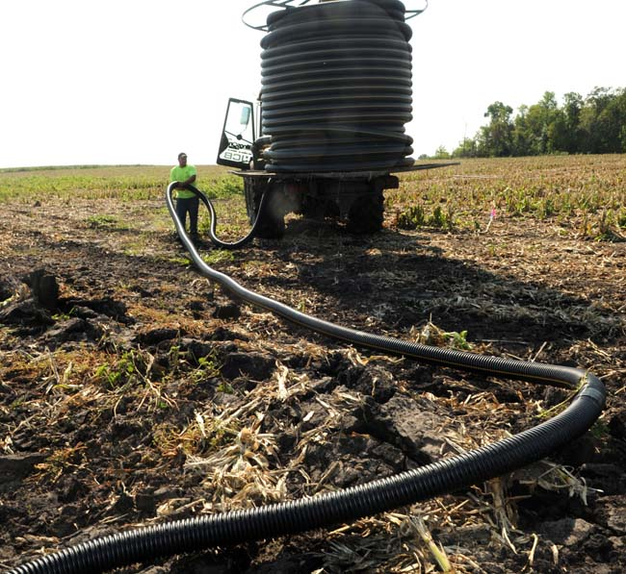
# 7--Keeping Water on the Land
Most complex of the recommendations
Water retention improves soil health, water quality and gw recharge
Suggest needs:
Support agency evaluations of most effective BMPs, at the best locations
Increase general fund obligation for targeted/efficient/incentivized BMPS
Determine extent and impact of tile drains
Support ROI evaluations of BMPs
Support consensus positions from the DWG
Increase incorporation of BMPs in 1 watershed/1 plan
Evaluate urban BMPS
Revise HF3908 to include local water planning and implementation to include TMDLs, WRAPs, and 1W/1 Plan
Expand pilot pollutant trading following LCCMR pilots
Create trading credit- exchange vehicle
Expand and fund expansion of agency programs
Increase general funding
Create interagency/watershed efforts to coordinated plans

Slide 20
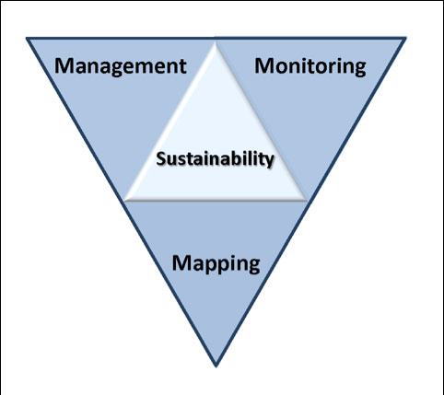
# 8: Ensuring Water Sustainability--Information, Education and Awareness
Enhance continue County Atlas Programs
Increase information about gw/sw interaction
Improve understanding or water bank accounts
Incorporate water balances analysis in Co Atlas and 1W/Plan processes
Expand gw management area assessments
Increase educational and outreach activities
Legislative direction and funding for
existing agency, MGS and watersheds
Notes:
Protection of ground water and surface water resources will require substantial investments from a diversity of funding sources over all levels of government during the next decade. As a part of this effort, this program of mapping, monitoring and managing is necessary to deliver the basic understanding of the hydrologic system for both surface and groundwater.

Slide 21
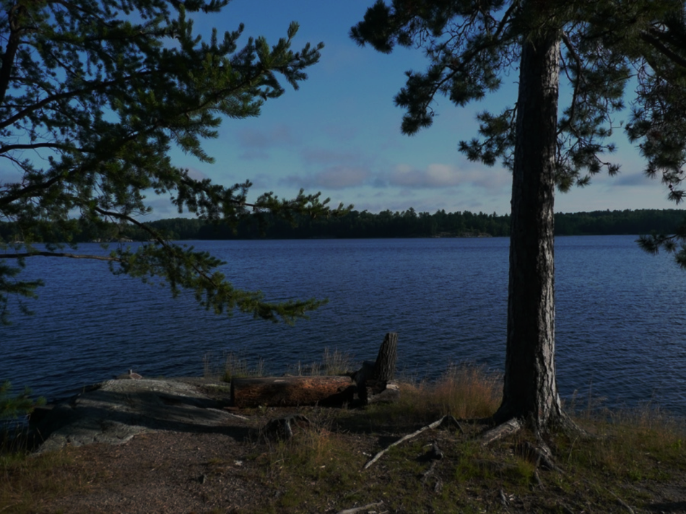
#9 Lakes--Preserving and Protect
MN lakes are aging and threatened
We can’t protect all of them
Policy is needed
Protect and preserve the most important: ex Cold water lakes
Strategic data collection- Sentinel lakes
Establish lake priorities
Increase conservation easement for priority lakes
Accelerate efforts to control invasive species
Prepare management strategy for uncertain future
Increase and coordinate agency programs
Increase general fund support

Slide 22
# 10: Expand Source Water Protection (MDH)
Expand programs to rivers
Include aquifers– private wells
Identify most vulnerable aquifers
Increase real-time monitoring for rivers Improve public information and outreach
Support CWC’s efforts to increase vegetative cover
Encourage new markets
Increase general fund obligations (MDH)
Increase and coordinate agency programs
Coordinate with CWC/ LCCMR

Slide 23
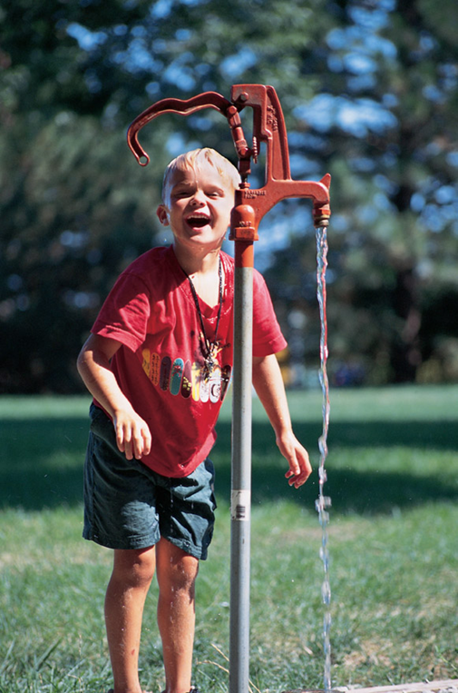
# 11—Increase Water Service Connection Fee
Fee structure has been static
Program costs have increased
Increasing needs for condition assessments (Lead for example)
Growing need for asset management plans
Legislation needed to increase fees

Slide 24
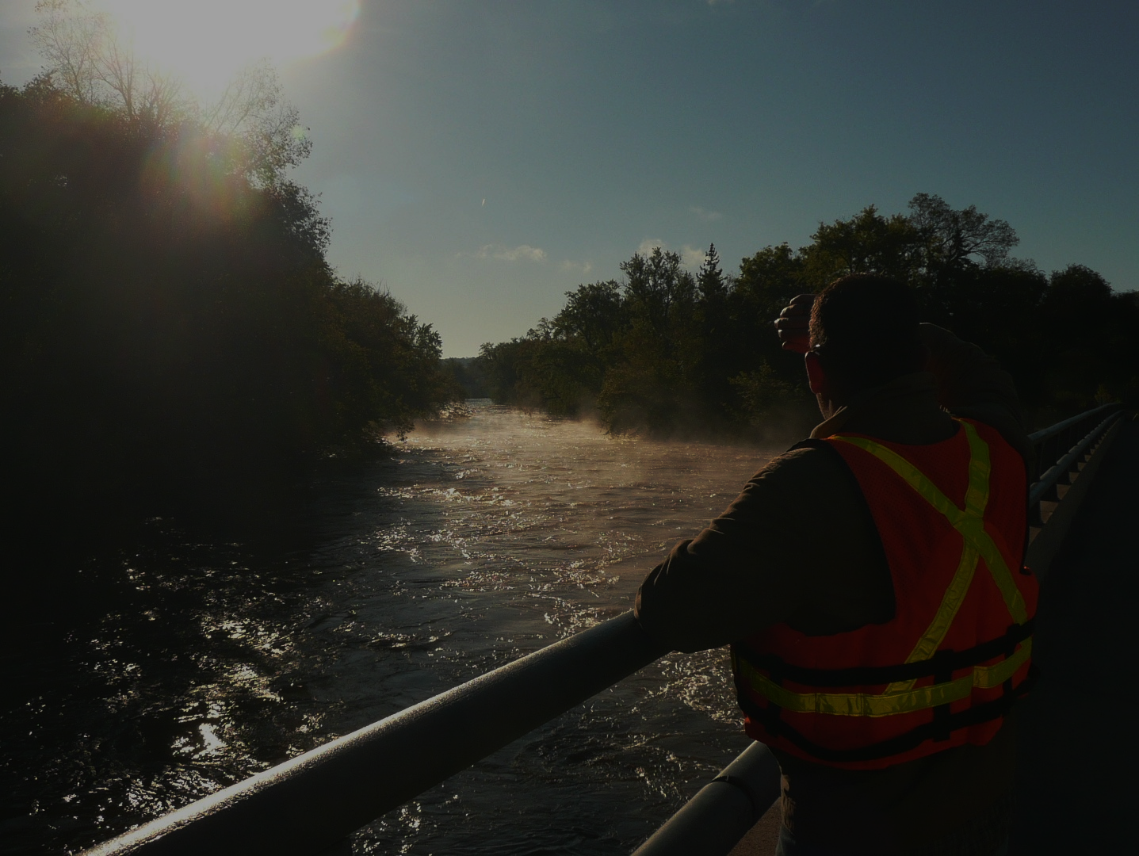
# 12 Statewide Water Policy
As a state, we need to plan for an uncertain future
Provide adaptation plans for changes– long term roadmap
Incorporate the other recommendations- Involve stakeholders
Address emerging issues
Balance water resource needs with economic health
Consider:
Climate and weather changes
Infrastructure resiliency
Lake preservation
Water sustainability
Water quality
Mineral extraction
Population change
Land use Change and use change
Provide general funds and guidance for an interagency/legislative roadmap for future legislation and policy
24

Slide 25
Member Discussion
Notes:
to the northern forests

Slide 26
Short Break
10 minutes
26

Slide 27
Jim Riedel
Regional Trade Manager
Western Europe
Environment and Energy Industries
MN Employment and Economic Development
Notes:
For more information and real time monitoring data you can visit this web site.

Slide 28
Member Consensus
28

Slide 29
Next Steps?
29

Slide 30
Next Steps
Revise Issue Statements
Revise Recommendations
Initial Consensus from LWC
Feedback from Stakeholders
Consolidate recommendations into recommendation themes
LWC Consensus
Recommendations to Legislature
Legislative briefings with Environmental Committees/Agency staff

Slide 31
2018 Meeting Schedule
Future LWC meetings: Discuss meeting times
November 13 ( Recommendations to Legislature)
December 10

Slide 32
Thank You!
Notes:
For more information and real time monitoring data you can visit this web site.

